Slide 1
4-H Mock Legislature
4-H LEG prep: Lesson 4

Slide 2
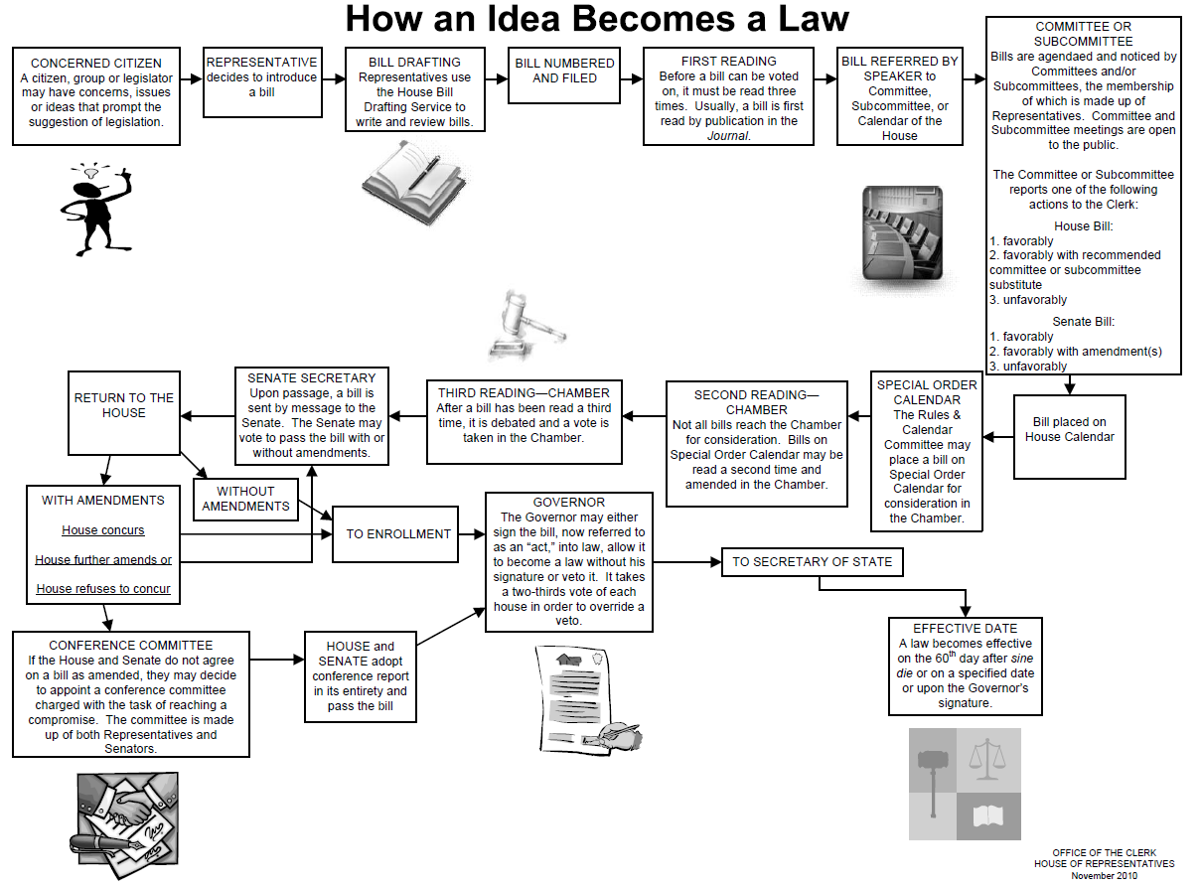

Slide 3
Bill No. ED01
A Bill to Be Entitled
An act relating to the freedom of students to skip school on their birthday.
Be it hereby enacted by the Mock Legislature:
Section 1 is created to read: On the anniversary of your birth it is not mandatory for students to attend school. This will not be considered as you being tardy nor will there be consequences for skipping.
Section 2: It shall hereby be required for all students to notify the school’s administration office the day before their birthday.
Section 3: This shall take effect in the state of Florida upon becoming a law.
_______________________________________________________________
SUMMARY
This bill will allow students to skip school on their birthday.

Slide 4
Bill No. ED02
A Bill to Be Entitled
An act relating to all algebra teachers.
Be it hereby enacted by the Mock Legislature:
Section 1 is created to read: It is mandatory for every algebra teacher to weekly give an example of how what the students are learning can apply to their lives.
Section 2: This bill will apply to any public or private school, college or university in Florida.
Section 3: Shall take effect upon becoming a law.
_______________________________________________________________
SUMMARY
This bill will require algebra teachers to give an example of how algebra applies to life.

Slide 5
Bill No. GCT01
A Bill to Be Entitled
An act relating to appointing Lady Gaga Supreme Governor of Florida
Be it hereby enacted by the Mock Legislature:
Section 1 is created to read: Whereas, Lady Gaga is one of the greatest performers in the history of music. And whereas, Lady Gaga is the example of greatness for all Floridians to follow. The following shall be enacted:
Section 2: A new position shall be created in the Florida government and this position shall be called “Supreme Governor”. This position allows Lady Gaga to do whatever she wants, whenever she wants, with anything that even remotely concerns the State of Florida.
Section 3: The position of Supreme Governor that Lady Gaga shall inherit will be the highest political position in the State of Florida placing her of even more importance than the Governor.
Section 4: This act shall take effect upon becoming a law.
_______________________________________________________________
SUMMARY
This bill would place Lady Gaga as Supreme Governor in the State of Florida giving her power over all other political entities.

Slide 6
Bill No. GTC02
A Bill to Be Entitled
An act relating to changing the legal voting age from 18 to 12.
Be it hereby enacted by the Mock Legislature:
Section 1 is created to read: The legal voting age shall be changed from age 18 to age 12.
Section 2: This bill shall take effect upon becoming a law.
_______________________________________________________
SUMMARY
This bill changes the legal voting age from 18 to 12.

Slide 7
Bill No. HHS01
A Bill to Be Entitled
An act relating to chips emplaced in children.
Be it hereby enacted by the Mock Legislature:
Section 1 is created to read: All children shall, at birth, be implanted with a chip that can track GPS position, as well as relay critical medical information to a central database should the child go missing/be abducted/get lost in the woods/get lost at sea/talk to strangers/take candy from strangers etc.
Section 2: Parents who refuse this bill shall be punished as follows:
Birth parents shall spend their birthday each year in a county jail.
Birth parents shall be required to purchase and provide their child with junk food and candy whenever the said child desires.
Section 4: This shall take effect upon becoming a law.
_______________________________________________________________
SUMMARY
This bill shall make it mandatory for all children to have a chip inserted at birth.

Slide 8
Bill No. HHS02
A Bill to Be Entitled
An act relating all Florida 4-H Camp’s food
Be it hereby enacted by the Mock Legislature:
Section 1 is created to read: During all 4-H events held at a Florida 4-H Camp, sweets and deserts shall be removed from the Camp food selection, being replaced by vegetables.
Section 2: In an effort to enforce healthy eating a new position shall be added to the Committee members in charge of the event.
The new position shall be a senior who will act as a guard.
The guard shall inspect trays attempted to be dumped with vegetables.
In the case the vegetables are left uneaten it shall be returned to the owner for them to finish.
Section 3: This bill shall take effect upon becoming a law.
_______________________________________________________________
SUMMARY
This bill requires 4-Her’s attending camp to eat their vegetables.

Slide 9
Bill No. JJ01
A Bill to Be Entitled
An act relating to juveniles learning how to quilt.
Be it hereby enacted by the Mock Legislature:
Section 1 is created to read: Juveniles will be subject to daily quilting lessons.
Section 2: Their sentence will not be complete until at least one quilt of quality has been sewn.
Section 3. This shall take effect upon becoming a law.
______________________________________________________________
SUMMARY
This bill shall make juveniles quilt.

Slide 10
Bill No. JJ02
A Bill to Be Entitled
An act relating to the picking of noses during school hours.
Be it hereby enacted by the Mock Legislature:
Section 1: It shall be illegal to “Pick your nose” while on school property during school hours. “Pick your nose” is defined as removing the dust and dirt buildup in the nasal cavity by inserting a finger or other object into the nose and moving it in such a fashion as to remove whatever lies inside.
Section 2: Punishment for breaking this law shall be that the person in question is required to ingest the object removed from the nose as well as any objects found on the underside of the student's desk.
Section 3: Students shall be allowed to pick their nose during after-school activities such as athletic events and pep rallys as well as in after-school detention.
Section 4: This bill shall take effect upon becoming a law.
_______________________________________________________________
SUMMARY
This bill shall make it illegal to pick your nose during school.

Slide 11
Bill No. CJ01
A Bill to Be Entitled
An act relating to repealing the death penalty.
Be it hereby enacted by the Mock Legislature:
Section 1 is created to read: The death penalty shall be abolished.
Section 2: All inmates on death row will be given a life in prison sentence.
_______________________________________________________
SUMMARY
This bill will abolish the death penalty.

Slide 12
Bill No. AG01
A Bill to Be Entitled
An act relating to the illegalization of eating chicken, pork or beef in the presence of the breed.
Be it hereby enacted by the Mock Legislature:
Section 1: It shall be illegal to partake of chicken, pork or beef if there is a chicken, pig or cow within 2 square miles of the dining table.
Section 2: This bill is created in an effort to reduce the heartache suffered by the chickens, pigs and cows. The mental and emotional trauma suffered by said animals is greatly magnified by seeing a like breed consumed.
_______________________________________________________________
SUMMARY
This bill will make it illegal to partake of animal meat in the presence of animals.

Slide 13
SHARING
What was the hardest part of this activity?
What other types of occasions have you had to follow specific rules? How about times you needed to make introductions or “speak off the cuff?”

Slide 14
PROCESSING
Were there any bills that someone wanted to see passed but which were defeated?
Besides the legislature, what groups follow formal rules to make decisions?

Slide 15
GENERALIZING
Why does how you speak in public affect what people think of you?
Why is it important to be a good citizen?
Is it difficult to get bad laws passed using the process our government uses? Why?

Slide 16
APPLYING
What are some of your ideas for real laws?
What would you have to do to get your ideas made into real laws?
How can you use the ideas learned here in other places in your life (outside of 4-H)?

