Slide 1
Florida Arthropods & Non-Arthropods

Slide 2
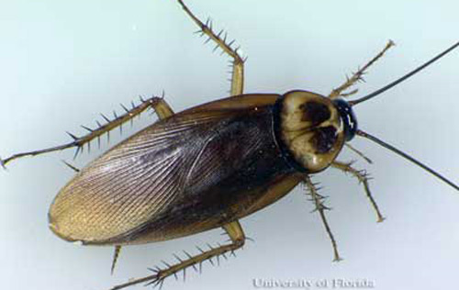
J I S

Slide 3
Palmetto Cockroach
Scientific Name: Periplaneta americana
Order: Blattodea
Largest of the common cockroaches
Occurs in buildings throughout Florida
Three life stages: egg, variable number of nymphal instars, adult
Omnivorous and opportunistic feeder
Description:

Slide 4
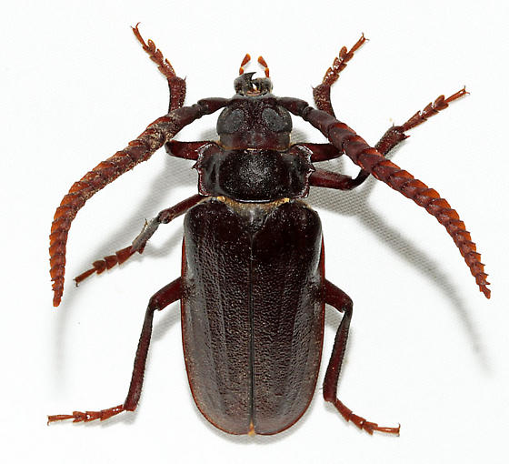
I S

Slide 5
Prionus Long-horned Beetle
Scientific Name:
Order: Coleoptera
Feed within dead, dying, or decaying wood

Slide 6
J I S

Slide 7
Long-horned Beetle
Scientific Name:
Order: Coleoptera
Feed within dead, dying, or decaying wood

Slide 8
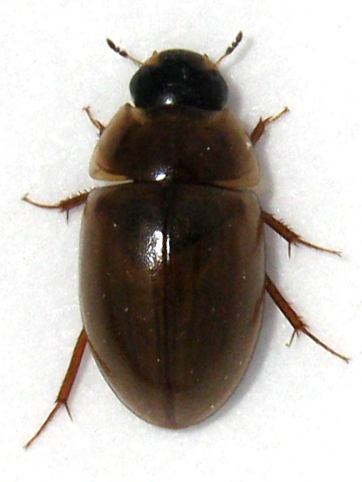
J I S

Slide 9
Water Scavenger Beetle
Scientific Name:
Order: Coleoptera
Mostly aquatic
Scavengers – feed on dead plant and animal material
Sometimes predatory

Slide 10
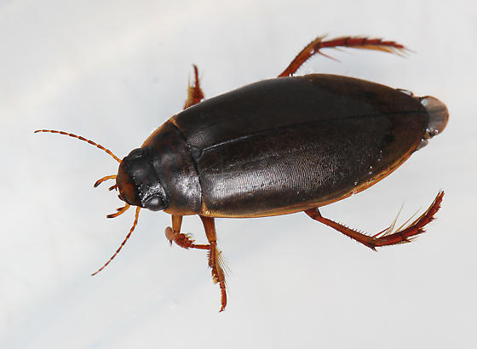
I S

Slide 11
Predacious Diving Beetle
Scientific Name:
Order: Coleoptera
Mostly aquatic
Larva commonly known as water tigers

Slide 12
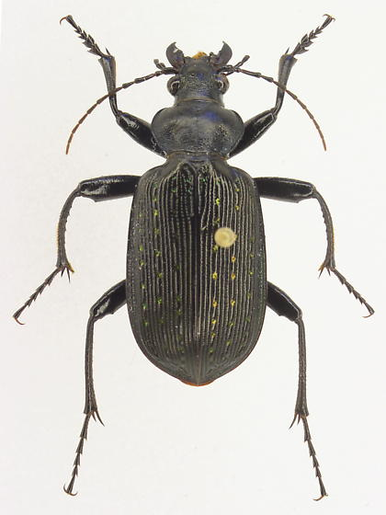
S

Slide 13
Caterpillar Hunter
Scientific Name:
Order: Coleoptera
Predatory on other insects, especially caterpillars

Slide 14
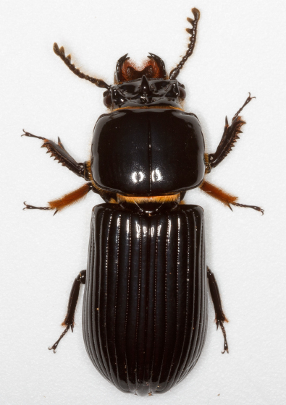
J I S

Slide 15
Bess Beetle
Scientific Name:
Order: Coleoptera

Slide 16
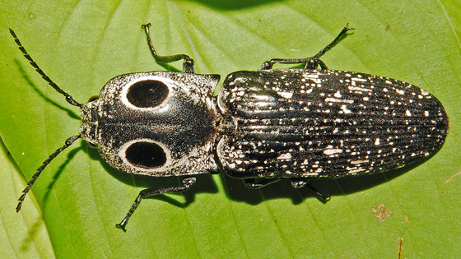
S

Slide 17
Eyed Click Beetle
Scientific Name:
Order: Coleoptera

Slide 18
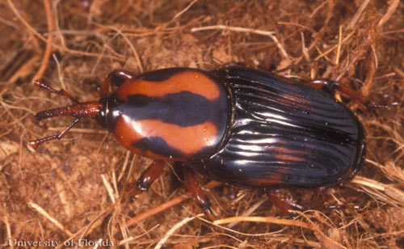
S

Slide 19
Palm Weevil
Scientific Name:
Order: Coleoptera

Slide 20
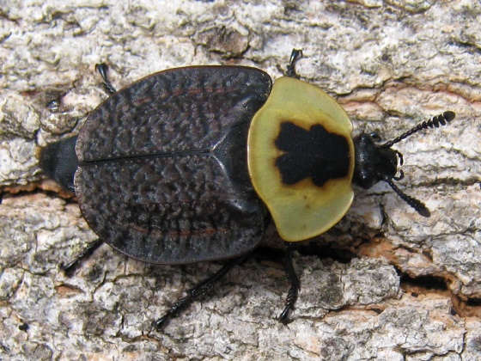
I S

Slide 21
Carrion Beetle
Scientific Name:
Order: Coleoptera

Slide 22
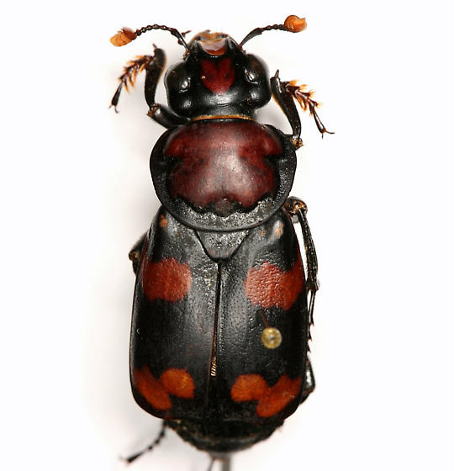
I S

Slide 23
Burying Carrion Beetle
Scientific Name:
Order: Coleoptera

Slide 24
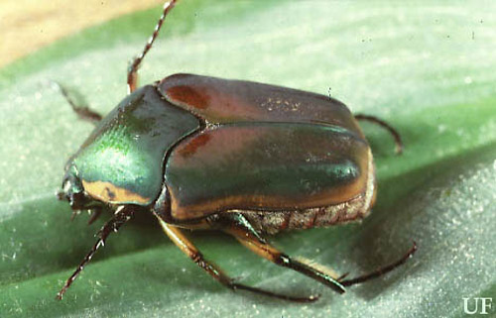
J I S

Slide 25
June (or May) Beetle
Scientific Name:
Order: Coleoptera

Slide 26
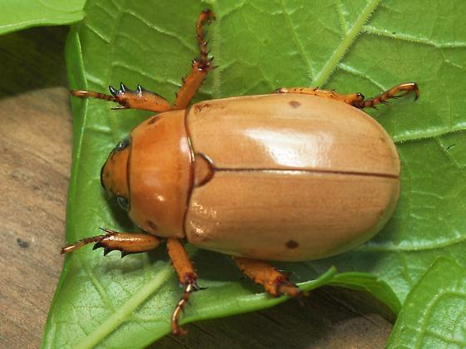
J I S

Slide 27
Grape Pelidnota
Scientific Name:
Order: Coleoptera

Slide 28
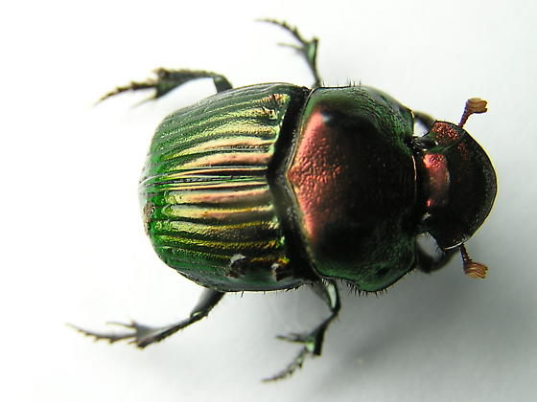
S

Slide 29
Phanaeus Dung Beetle
Scientific Name:
Order: Coleoptera

Slide 30
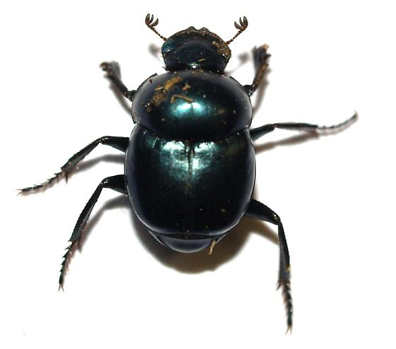
I S

Slide 31
Canthon Dung Beetle
Scientific Name:
Order: Coleoptera

Slide 32
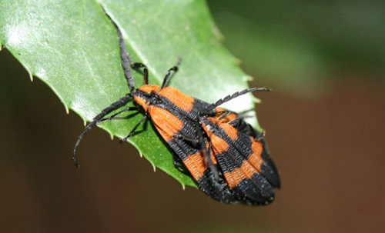
S

Slide 33
Net-winged Beetle
Scientific Name:
Order: Coleoptera

Slide 34
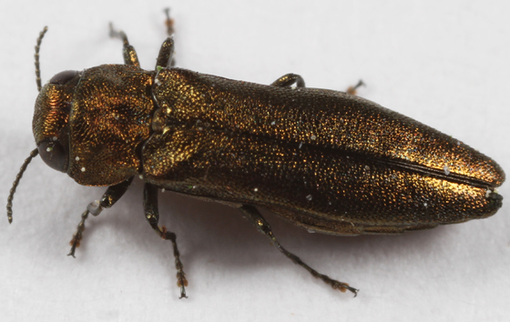
S

Slide 35
Metallic Wood-boring Beetle
Scientific Name:
Order: Coleoptera

Slide 36
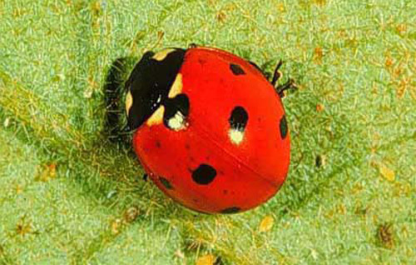
J I S

Slide 37
Lady Bird Beetle
Scientific Name:
Order: Coleoptera

Slide 38
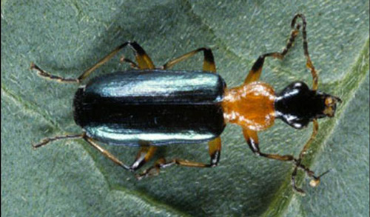
J I S

Slide 39
Ground Beetle
Scientific Name:
Order: Coleoptera

Slide 40
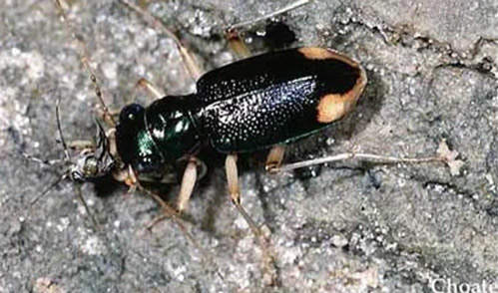
I S

Slide 41
Tiger Beetle
Scientific Name:
Order: Coleoptera

Slide 42
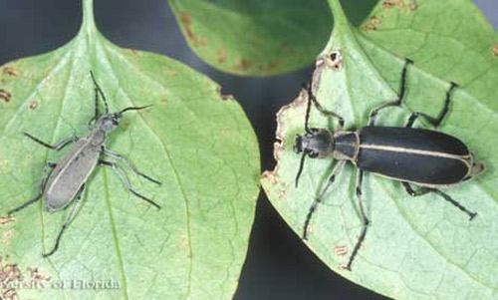
S

Slide 43
Blister Beetle
Scientific Name:
Order: Coleoptera

Slide 44
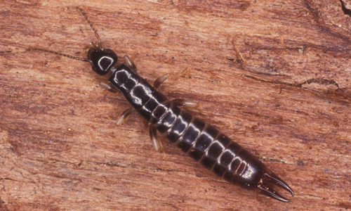
J I S

Slide 45
Earwig
Scientific Name:
Order: Dermaptera

Slide 46
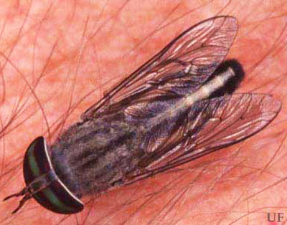
J I S

Slide 47
Horse Fly
Scientific Name:
Order: Diptera

Slide 48
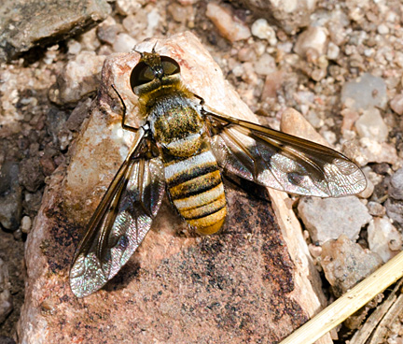
S

Slide 49
Bee Fly
Scientific Name:
Order: Diptera

Slide 50
S

Slide 51
Syrphid Fly
Scientific Name:
Order: Diptera

Slide 52
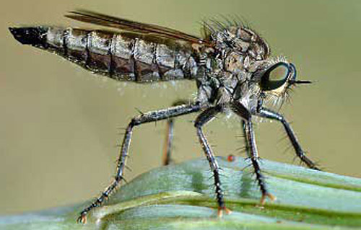
I S

Slide 53
Robber Fly
Scientific Name:
Order: Diptera

Slide 54
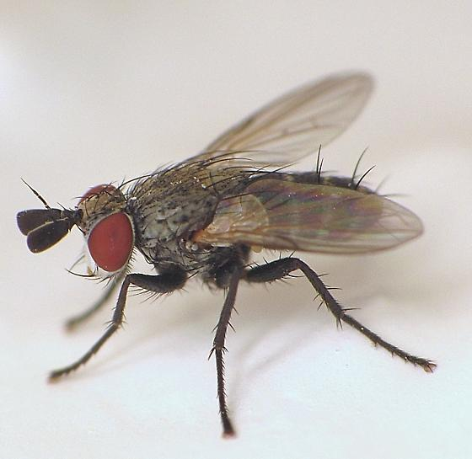
S

Slide 55
Tachinid Fly
Scientific Name:
Order: Diptera

Slide 56
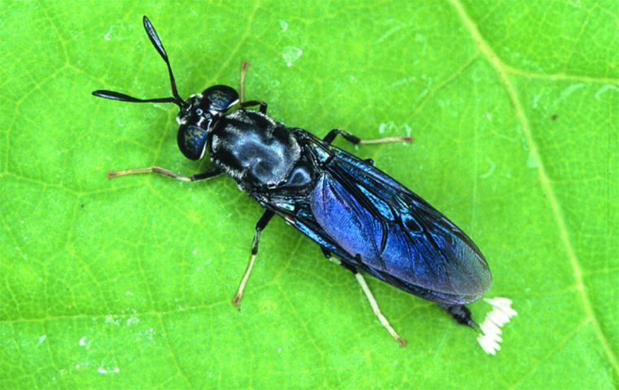
I S

Slide 57
Soldier Fly
Scientific Name:
Order: Diptera

Slide 58
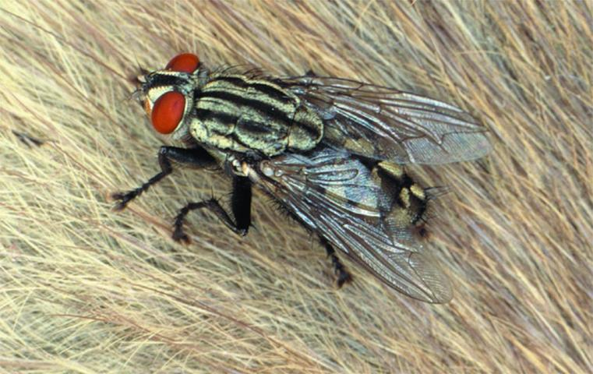
S

Slide 59
Flesh Fly
Scientific Name:
Order: Diptera

Slide 60
J I S

Slide 61
House Fly
Scientific Name:
Order: Diptera

Slide 62
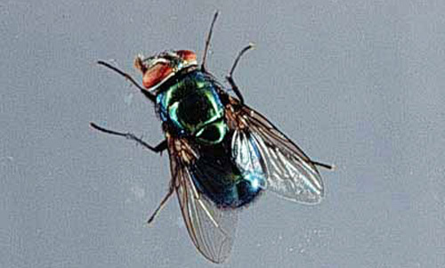
S

Slide 63
Blow Fly
Scientific Name:
Order: Diptera

Slide 64
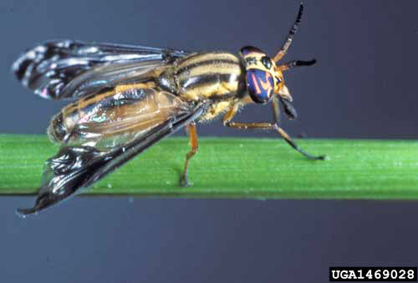
I S

Slide 65
Deer Fly
Scientific Name:
Order: Diptera

Slide 66
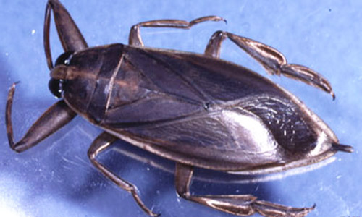
J I S

Slide 67
Giant Water Bug
Scientific Name:
Order: Hemiptera

Slide 68
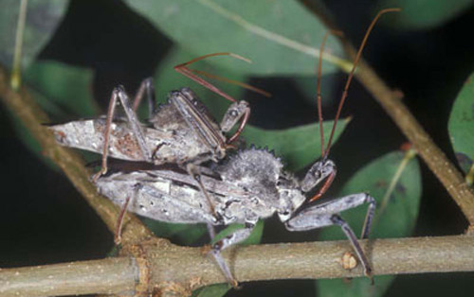
S

Slide 69
Wheel (Assassin) Bug
Scientific Name:
Order: Hemiptera

Slide 70
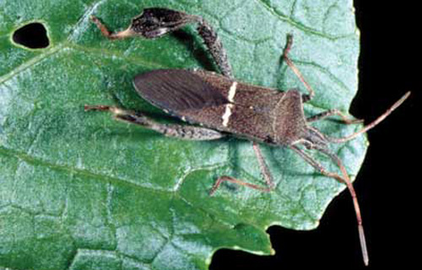
J I S

Slide 71
Leaf-footed Bug
Scientific Name:
Order: Hemiptera

Slide 72
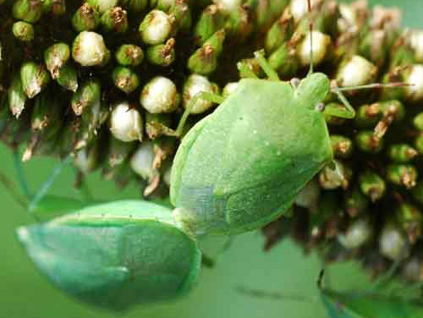
J I S

Slide 73
Green Stink Bug
Scientific Name:
Order: Hemiptera

Slide 74
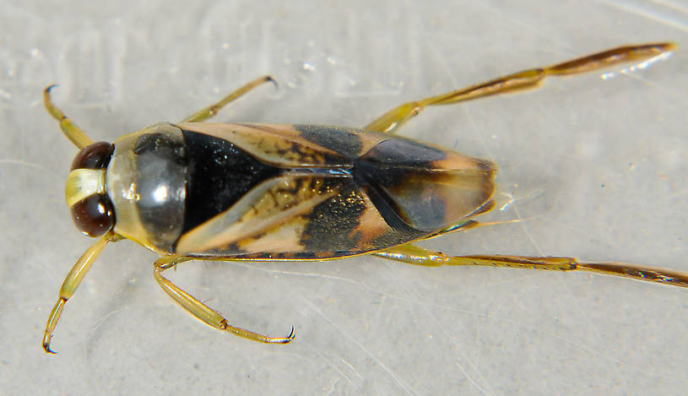
S

Slide 75
Backswimmer
Scientific Name:
Order: Hemiptera

Slide 76
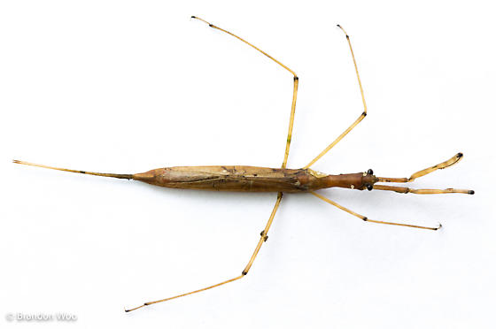
J I S

Slide 77
Water Scorpion
Scientific Name:
Order: Hemiptera

Slide 78
J I S

Slide 79
Cicada
Scientific Name:
Order: Hemiptera

Slide 80
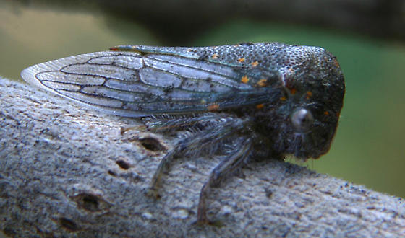
S

Slide 81
Treehopper
Scientific Name:
Order: Hemiptera

Slide 82
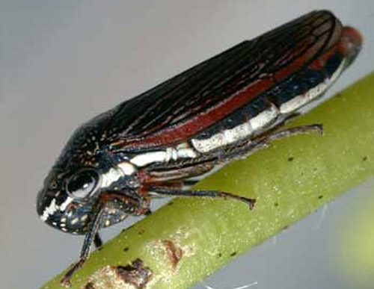
I S

Slide 83
Leafhopper
Scientific Name:
Order: Hemiptera

Slide 84
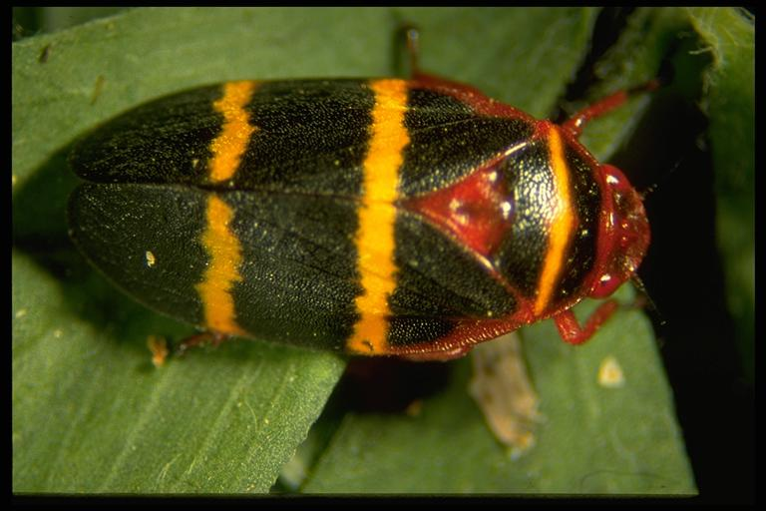
I S

Slide 85
Two-lined Spittlebug
Scientific Name:
Order: Hemiptera

Slide 86
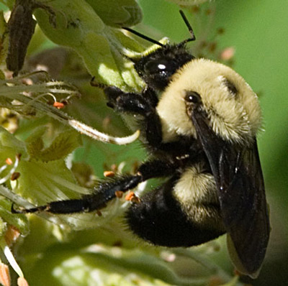
J I S

Slide 87
Bumble Bee
Scientific Name:
Order: Hymenoptera

Slide 88
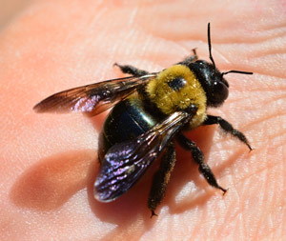
J I S

Slide 89
Carpenter Bee
Scientific Name:
Order: Hymenoptera

Slide 90
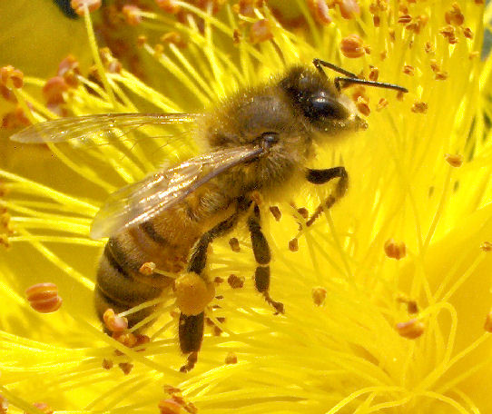
J I S

Slide 91
Honey Bee
Scientific Name:
Order: Hymenoptera

Slide 92
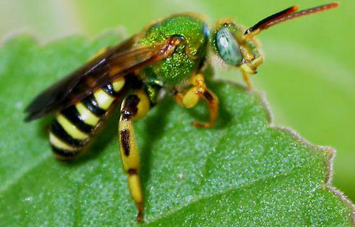
S

Slide 93
Halictid Bee
Scientific Name:
Order: Hymenoptera

Slide 94
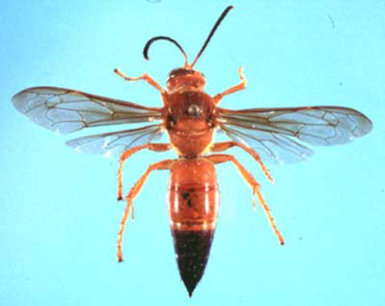
S

Slide 95
Cicada Killer Wasp
Scientific Name:
Order: Hymenoptera

Slide 96
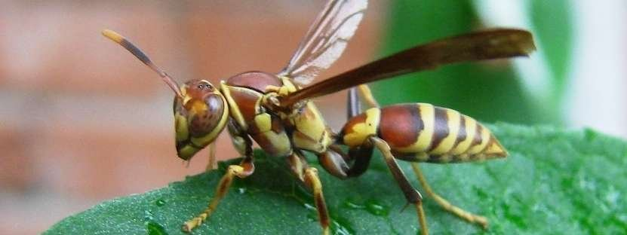
I S

Slide 97
Polistes Paper Wasp
Scientific Name:
Order: Hymenoptera

Slide 98
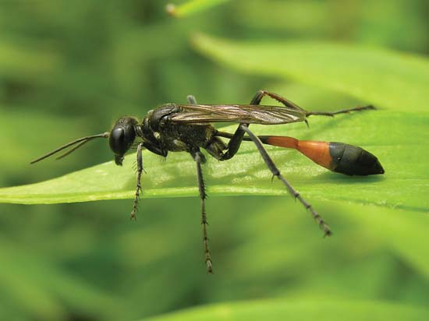
S

Slide 99
Thread-waisted Wasp
Scientific Name:
Order: Hymenoptera

Slide 100
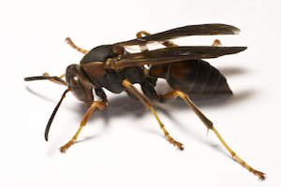
J I S

Slide 101
Mud Dauber Wasp
Scientific Name:
Order: Hymenoptera

Slide 102
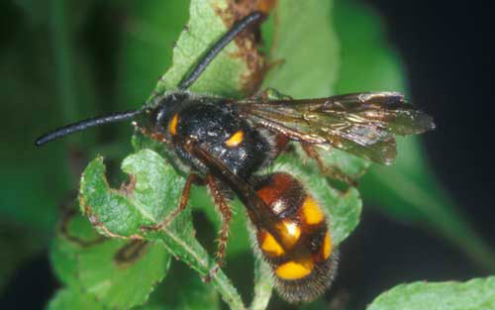
S

Slide 103
Scoliid Wasp
Scientific Name:
Order: Hymenoptera

Slide 104
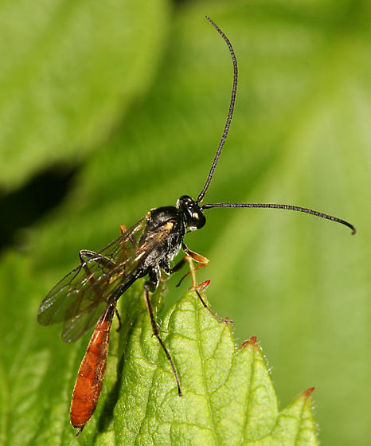
S

Slide 105
Ichneumon Wasp
Scientific Name:
Order: Hymenoptera

Slide 106
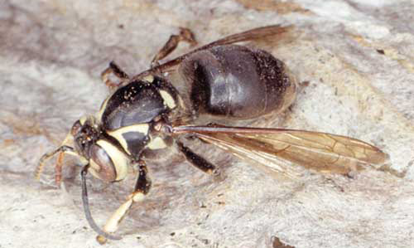
I S

Slide 107
Bald-faced Hornet
Scientific Name:
Order: Hymenoptera

Slide 108
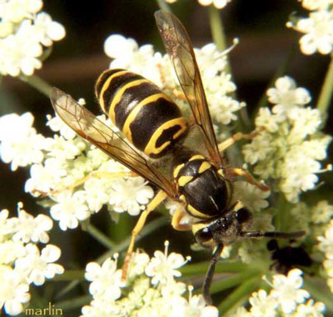
J I S

Slide 109
Yellowjacket Wasp
Scientific Name:
Order: Hymenoptera

Slide 110
J I S

Slide 111
Velvet Ant
Scientific Name:
Order: Hymenoptera

Slide 112
J I S

Slide 113
Giant Swallowtail
Scientific Name:
Order: Lepidoptera

Slide 114
S

Slide 115
Laurel (Palemedes) Swallowtail
Scientific Name:
Order: Lepidoptera

Slide 116
I S

Slide 117
Tiger Swallowtail
Scientific Name:
Order: Lepidoptera

Slide 118
I S

Slide 119
Tiger Swallowtail (Dark Morph)
Scientific Name:
Order: Lepidoptera

Slide 120
I S

Slide 121
Spicebush Swallowtail
Scientific Name:
Order: Lepidoptera

Slide 122
I S

Slide 123
Black (American) Swallowtail
Scientific Name:
Order: Lepidoptera

Slide 124
I S

Slide 125
Blue (Pipevine) Swallowtail
Scientific Name:
Order: Lepidoptera

Slide 126
J I S

Slide 127
Gulf Fritillary
Scientific Name:
Order: Lepidoptera

Slide 128
J I S

Slide 129
Zebra Longwing
Scientific Name:
Order: Lepidoptera

Slide 130
J I S

Slide 131
Monarch
Scientific Name:
Order: Lepidoptera

Slide 132
J I S

Slide 133
Viceroy
Scientific Name:
Order: Lepidoptera

Slide 134
J I S

Slide 135
Red-spotted Purple
Scientific Name:
Order: Lepidoptera

Slide 136
I S

Slide 137
Tawny Emperor
Scientific Name:
Order: Lepidoptera

Slide 138
S

Slide 139
Hackberry Butterfly
Scientific Name:
Order: Lepidoptera

Slide 140
I S

Slide 141
Red Admiral
Scientific Name:
Order: Lepidoptera

Slide 142
I S

Slide 143
American Painted Lady
Scientific Name:
Order: Lepidoptera

Slide 144
S

Slide 145
Buckeye Butterfly
Scientific Name:
Order: Lepidoptera

Slide 146
I S

Slide 147
Barred Sulfur (Summer Form)
Scientific Name:
Order: Lepidoptera

Slide 148
I S

Slide 149
Barred Sulfur (Winter Form)
Scientific Name:
Order: Lepidoptera

Slide 150
J I S

Slide 151
Cloudless Sulfur
Scientific Name:
Order: Lepidoptera

Slide 152
S

Slide 153
Little Sulfur
Scientific Name:
Order: Lepidoptera

Slide 154
S

Slide 155
European Cabbage Butterfly
Scientific Name:
Order: Lepidoptera

Slide 156
I S

Slide 157
Checkered White
Scientific Name:
Order: Lepidoptera

Slide 158
I S

Slide 159
Silver-spotted Skipper
Scientific Name:
Order: Lepidoptera

Slide 160
J I S

Slide 161
Long-tailed Skipper
Scientific Name:
Order: Lepidoptera

Slide 162
J I S

Slide 163
Polyphemus Moth
Scientific Name:
Order: Lepidoptera

Slide 164
J I S

Slide 165
Luna Moth
Scientific Name:
Order: Lepidoptera

Slide 166
S

Slide 167
Tobacco Hornworm Moth
Scientific Name:
Order: Lepidoptera

Slide 168
I S

Slide 169
Io Moth
Scientific Name:
Order: Lepidoptera

Slide 170
S

Slide 171
Underwing Moth
Scientific Name:
Order: Lepidoptera

Slide 172
I S

Slide 173
Polka-dot Wasp Moth
Scientific Name:
Order: Lepidoptera

Slide 174
I S

Slide 175
Eastern Tent Caterpillar Moth
Scientific Name:
Order: Lepidoptera

Slide 176
S

Slide 177
Clearwing Sphinx Moth
Scientific Name:
Order: Lepidoptera

Slide 178
J I S

Slide 179
Clearwing Sphinx Moth
Scientific Name:
Order: Lepidoptera

Slide 180
J I S

Slide 181
Praying Mantid
Scientific Name:
Order: Mantodea

Slide 182
S

Slide 183
Dobsonfly
Scientific Name:
Order: Megaloptera

Slide 184
I S

Slide 185
Antlion Adult
Scientific Name:
Order: Neuroptera

Slide 186
S

Slide 187
Owlfly
Scientific Name:
Order: Neuroptera

Slide 188
I S

Slide 189
Green Lacewing
Scientific Name:
Order: Neuroptera

Slide 190
J I S

Slide 191
Green Darner Dragonfly
Scientific Name:
Order: Neuroptera

Slide 192
J I S

Slide 193
Black-winged Damselfy
Scientific Name:
Order: Neuroptera

Slide 194
I S

Slide 195
Lubber Grasshopper
Scientific Name:
Order: Orthoptera

Slide 196
J I S

Slide 197
American Grasshopper
Scientific Name:
Order: Orthoptera

Slide 198
J I S

Slide 199
Katydid
Scientific Name:
Order: Orthoptera

Slide 200
J I S

Slide 201
Mole Cricket
Scientific Name:
Order: Orthoptera

Slide 202
J I S

Slide 203
Field Cricket
Scientific Name:
Order: Orthoptera

Slide 204
J I S

Slide 205
Florida Walkingstick
Scientific Name:
Order: Phasmatodea

Slide 206
J I S

Slide 207
Jumping Spider
Scientific Name:
Order: Arachnida

Slide 208
J I S

Slide 209
Crab Spider
Scientific Name:
Order: Arachnida

Slide 210
J I S

Slide 211
Golden Silk Spider
Scientific Name:
Order: Arachnida

Slide 212
S

Slide 213
Spiny Orb-weaver
Scientific Name:
Order: Arachnida

Slide 214
S

Slide 215
Black and Yellow Argiope Spider
Scientific Name:
Order: Arachnida

Slide 216
S

Slide 217
Green Lynx Spider
Scientific Name:
Order: Arachnida

Slide 218
J I S

Slide 219
Wolf Spider
Scientific Name:
Order: Arachnida

Slide 220
I S

Slide 221
Long-jawed Orb-weaver
Scientific Name:
Order: Arachnida

Slide 222
J I S

Slide 223
Brown Dog Tick
Scientific Name:
Order: Arachnida

Slide 224
S

Slide 225
American Dog Tick
Scientific Name:
Order: Arachnida

Slide 226
S

Slide 227
Black-legged Tick
Scientific Name:
Order: Arachnida

Slide 228
J I S

Slide 229
Lone Star Tick
Scientific Name:
Order: Arachnida

Slide 230
I S

Slide 231
Gulf Coast Tick
Scientific Name:
Order: Arachnida

Slide 232
S

Slide 233
Mites
Scientific Name:
Order: Arachnida

Slide 234
J I S

Slide 235
Daddy Long-legs
Scientific Name:
Order: Arachnida

Slide 236
I S

Slide 237
Florida Bark Scorpion
Scientific Name:
Order: Arachnida

Slide 238
J I S

Slide 239
Hentz Striped Scorpion
Scientific Name:
Order: Arachnida

Slide 240
S

Slide 241
Guiana Striped Scorpion
Scientific Name:
Order: Arachnida

Slide 242
J I S

Slide 243
Giant Whipped Scorpion (Vinegaroon)
Scientific Name:
Order: Arachnida

Slide 244
J I S

Slide 245
Millipedes
Scientific Name:
Order: Diplopoda

Slide 246
J I S

Slide 247
Centipedes
Scientific Name:
Order: Chilopoda

Slide 248
I S

Slide 249
Sowbugs
Scientific Name:
Order: Crustacea

Slide 250
J I S

Slide 251
Pillbugs
Scientific Name:
Order: Crustacea

